Slide 1
Best Practice for Tenant-Based Rental Assistance Programs
Kayon Henderson
Housing & Community Development Manager
City of Tampa

Slide 2
Presentation Overview
heather.johnson@davenportiowa.com
Background/History
Purpose
HUD Regulations for HOME Program
City of Tampa HOME TBRA Overview
Questions/Comments

Slide 3
Background/History
The HOME Investment Partnership Program (HOME) is an entitlement grant that is received by the City of Tampa from the Department of Housing and Urban Development (HUD)
The intent of the Program is to:
Provide decent affordable housing to lower income households
Expand the capacity of nonprofit housing providers
Address the City of Tampa’s Homeless Population

Slide 4
HUD Regulations – Allowable Uses
Eligible uses for HOME funds are:
Housing Development
Community Housing Development Organizations (CHDO)
Homeowner Rehabilitation
Homebuyer Activities
Rental Housing
Tenant Based Rental Assistance
Administration

Slide 5
Other HUD Requirements
Funds must be matched at 25% of the grant per year
HUD will allow cash or donated materials/services
Funds must be committed within 24 months and expended within 4 years
Annual Reports are required
City must enter client data in IDIS with accomplishments
Environmental reviews are required on all units (except for TBRA assisted units)
Long term compliance monitoring is required for all homes/units produced with HOME funds

Slide 6
Tenant Based Rental Assistance
HOME funded Tenant-Based Rental Assistance (TBRA) provides gap funds between what a renter can afford to pay and the actual rent amount
Using HOME funds for TBRA is ideal for jurisdictions with:
A high vacancy rate for standard housing that is not affordable to low- and very low-income households
Very high development costs, where it is more cost effective to provide a rental subsidy than to construct or rehabilitate housing units
Residents with special housing needs who need financial assistance to afford rent

Slide 7
Tenant Based Rental Assistance
Low-income households can receive HOME TBRA to help pay rent, utility costs, security deposits, and utility deposits
HOME TBRA Program is unique because:
It helps individual households
It can be used in a unit chosen by the tenant, and moves with the tenant
The amount of the rental subsidy is based on the income of the household, the particular unit the household selects, and the City’s rent standard

Slide 8
Tenant Based Rental Assistance
TBRA is Flexible
The City has the ability to tailor its TBRA program to meet the needs of its own community
Choose the population served; The City may design its program so that it serves the entire community, or focus only on a special purpose or specific housing need, such as elderly tenants, large families, or a special needs population that has been identified in the PJ’s Consolidated Plan
Choose the type of assistance provided; The City may provide assistance for rent and/or for security deposits in the form of grants or loans and provide utility deposit assistance in conjunction with security deposit assistance
While the program is intended to be short-term, it can be designed to provide assistance to a household for up to 24 months

Slide 9
City of Tampa HOME TBRA Program Overview
Prioritize HOME funds for Tenant-Based Rental Assistance (TBRA) to support activities to assist tenants affected
Provide annual TBRA recertification or provide TBRA coupons for homeless households. Security deposits may be provided as a grant to assist homeless households. Homeless households assisted shall be defined as individuals and families who meet the HUD definition of homeless; persons/households who are living in a place not meant for human habitation, in emergency shelter, in bridge housing or are exiting an institution where they temporarily resided.
This will meet immediate housing need of those displaced

Slide 10
City of Tampa HOME TBRA Program Overview
City will develop program that will take referrals directly from HMIS for placement
Agency will conduct intake with tenants to determine eligibility
Eligible tenants will receive a TBRA “coupon” and attend orientation for information on rents, unit requirements, etc.
Once a participant finds a unit, the City will work with them to have unit inspected, determine reasonable rent and get to lease-up

Slide 11
City of Tampa HOME TBRA Program Overview
Participants must identify a unit within the City limits of Tampa
Units must pass inspection and have a minimum lease term of one year.
Twenty-four-month clock begins on effective start date of lease
The City staff will coordinate with Continuum of Care (CoC) to anticipate need for this program on an annual basis

Slide 12
Overview of Agreement
City of Tampa released an RFP which was awarded to a local non-profit
City provided Policies and Procedures and technical assistance to the non-profit
In addition to the HOME regulatory requirements, the agreement outlines their scope of work in detail

Slide 13
Overview of Agreement Cont’d
Non-profit administers HOME TBRA and a SHIP rental and/or utility deposit program
HOME TBRA Responsibilities:
HOME funds will be used to assist individuals or families with rental assistance and rental security to obtain permanent housing. The subsidy level will be based on the household income and will be used for individuals or families in the Low to Extremely Low Area Medium Income (AMI).

Slide 14
Exhibit F

Slide 15
Landlord Packet
Program Integrity
Common Owner Violations
Payment Standards
Request for Tenancy Approval (RFTA)
Housing Rental Assistance Contract
Unit Inspection

Slide 16
MOUs with Support Service Providers
Reason
To provide the wrap around services needed to support the client through their transition
Benefit
Access to the program
Process
Coordinated Intake and Assessment

Slide 17
Program Success
Homeownership
Sustained income
Stable Housing
Partnerships
Family reunification

Slide 18
“Dare to Own the Dream” Homeownership Program (DARE)

Slide 19
DARE PROGRAM
The program provides up to $40,000
Maximum purchase price is $300,000
“Silent second” @ 0% interest rate
$0 monthly payment
Allowable Loan Types:
FHA
Conventional
VA

Slide 20
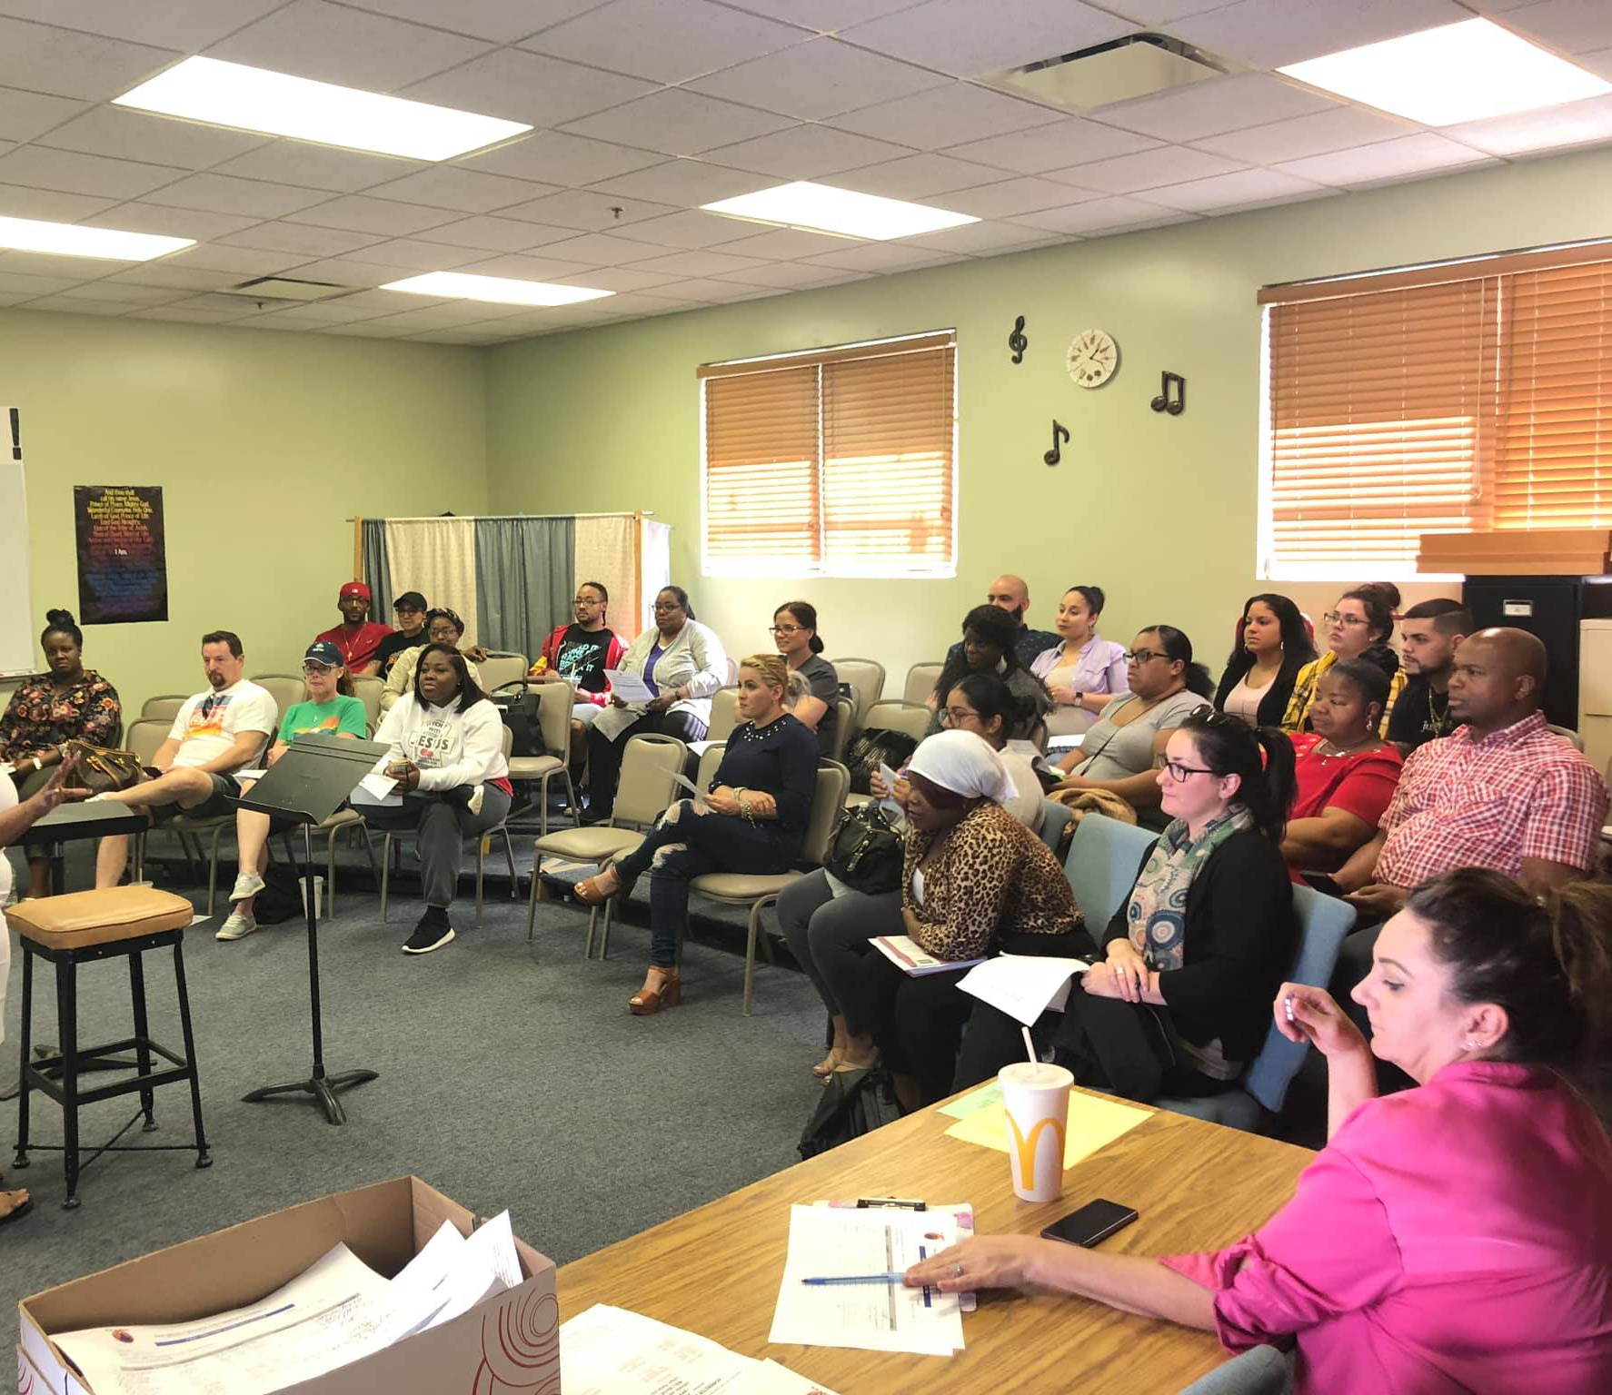
Buyer’s Requirement
Must be a 1st time home buyer
Must attend Home Buyer Education via an approved HCA
Must contribute a minimum of $2K toward the transaction
Must have minimum mid-credit score of 600
Must obtain reservation number prior to executing a purchase contract

Slide 21
Reservation Number
Reserves funding for the potential buyer that has been deemed eligible
Valid for 120 calendar days
One 90-day extension can be granted, if buyer is still shopping
Extension requests are submitted to the City from the HCA

Slide 22
DARE PROGRAM
Up to 140% Area Median Income (AMI)
0 – 50% AMI: $40,000.00
50.01% - 80% AMI: $30,000.00
80.01% - 120% AMI: $20,000.00
120.01% - 140% AMI: $15,000.00
Max award up to $40K toward purchase of the home of “gap” financing
First-come, first eligible basis
Loan term: 10 years
Provides $15K to $40K* of “gap” financing in the form of a 0%, deferred payment, subordinate mortgage toward down payment and closing costs. The purchase price cannot exceed the appraised value.
*Based on household’s AMI.

Slide 23
Applicant/Property Requirements
Buyer must be a 1st-time homebuyer
Eligible properties
Existing and new construction
1-4 family units, single-family detached, townhomes, and condos
No mobile homes; no manufactured homes
Maximum sales price - $300,000
Property must be located in the limits of the City of Tampa
Tax district – “TA Tampa” as listed by the Hillsborough County Property Appraiser

Slide 24
Underwriting
A two-phase process
1st phase begins at the issuance of the reservation number
2nd phase begins when the buyer goes under contract and the lender documents are received

Slide 25
Program Overview
 | DARE
Maximum Amount of Assistance | 40,000
AMI Limits | Up to 140%
Deferred Payment Loan/Grant | DPL
Boundaries | City Limits
Minimum Buyer Contribution | 2,000
Forgivable/Repayment Period | 10-15 years
Stand-alone Option | Yes
Loan Types Allowed | Conventional, FHA, VA
Homebuyer Education Required | Yes
Post-purchase Education Required | Yes
Allowed with other programs | Yes

Slide 26
Qualification Process
Buyer attends HBE Class/counseling session(s)
Application is submitted to the HCA
City approves or denies the reservation request
Applicant applies for mortgage loan from a City-approved lender
Home search begins with a City-approved realtor
HCA submits reservation request to the City
HCA completes third-party verifications
Executed sales contract & addendums are submitted to the City
City’s closing documents are provided to the title company
City’s Housing Quality Standards (HQS) inspection is requested & completed
Full Independent home inspection is completed
Documents are requested from a City- approved lender
ALL closing disclosures are provided to the City for approval
CDs approved, closing scheduled, and City’s wire initiated
City completes its underwriting and file is approved

Slide 27
Happy Homeowner
This Photo by Unknown Author is licensed under CC BY-SA-NC

Slide 28
Point of Contact
Kayon Henderson
Kayon.Henderson@tampagov.net
813-274-7999

Slide 29
Comments/Questions?

